Slide 1



Meta Paths and Meta Structures: Computing Relevance in Large Heterogeneous Information Networks
Dr. Reynold Cheng
Associate Professor
Department of Computer Science
The University of Hong Kong
ckcheng@cs.hku.hk

Slide 2


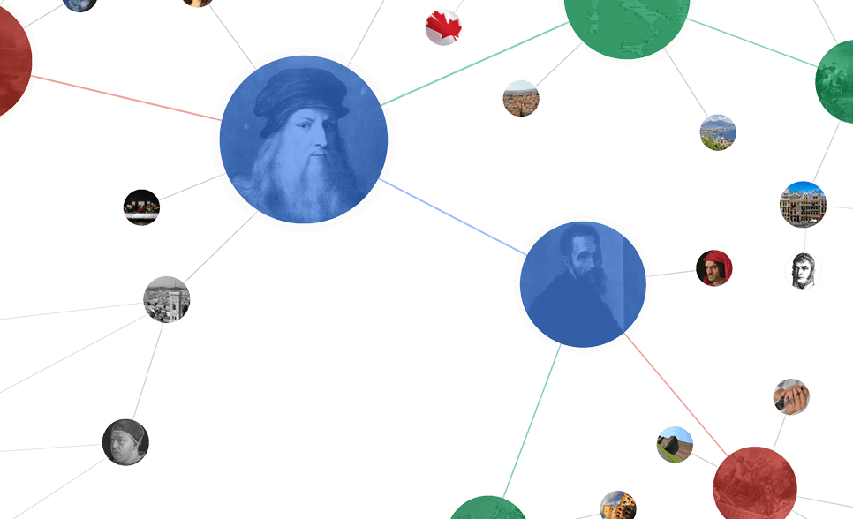

Heterogeneous Information Network (HIN)

Slide 3
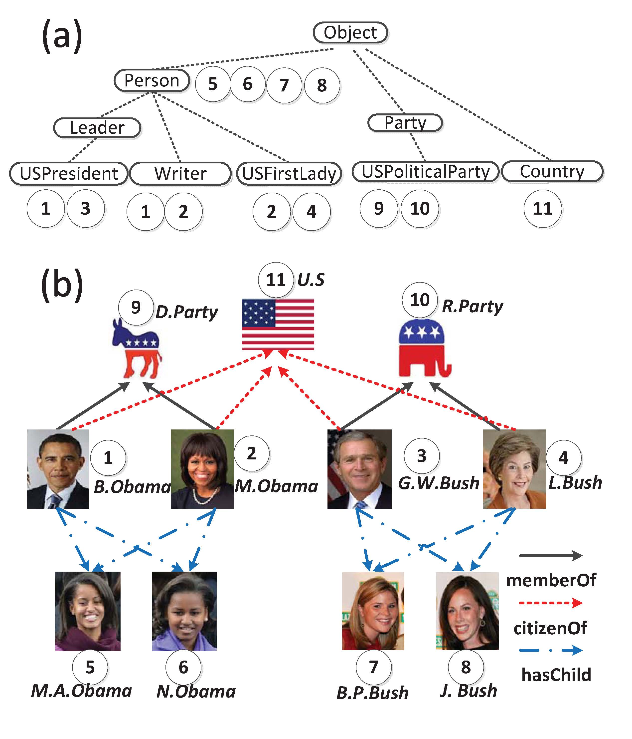
Heterogeneous Information Network (HIN)
citizenOf
hasChild
Notes:
modeled in a directed graph
Multiple node types
Hierarchy
Multiple edge types
Traditional measures cannot be used on HIN.
Relevance on HIN
Obama and Bush
Obama and the U.S.

Slide 4
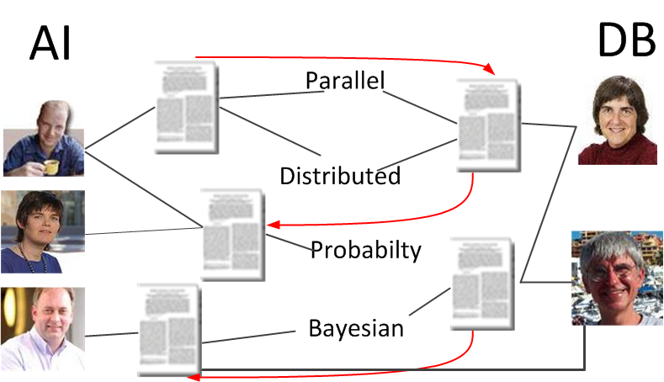
Application 1: Link Prediction
Coauthor prediction (which authors from DB and AI collaborate?)
Friendship prediction on Social Network

Slide 5
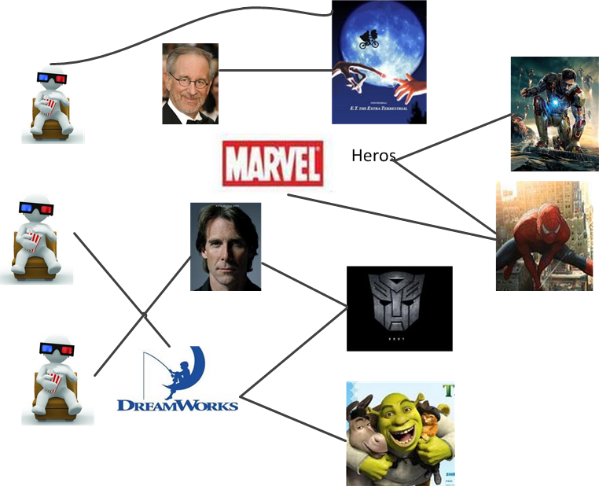
Application 2: Recommendation
Promote product to customers
Notes:
Choose representatives to Political or Commercial negotiations

Slide 6
Fundamental question: Relevance Computation
Is B. Obama relevant to
G. W. Bush?
citizenOf
hasChild
Notes:
modeled in a directed graph
Multiple node types
Hierarchy
Multiple edge types
Traditional measures cannot be used on HIN.
Relevance on HIN
Obama and Bush
Obama and the U.S.

Slide 7

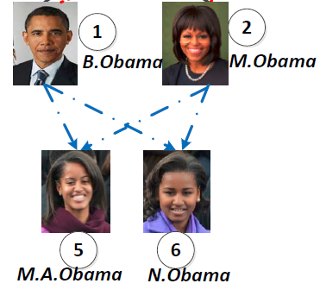
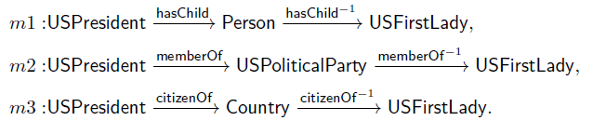
Meta Path [Sun VLDB’11]
Meta path: a sequence of node classes connected by edge types
Meta paths can be used to define
relevance between 2 nodes.
Notes:
Benefits of Meta Paths
Multi-hop relationships instead of direct links
Combine multiple relationships (linear combination)

Slide 8
Meta Path Relevance 1: Path Count (PC)
Path Count(PC) [Sun VLDB’11]
Number of the paths following a given meta path
PC(B.Obama, M.Obama) = 1+1=2, because there are two path instances.
PC biases popular objects with a large no. of links.
Notes:
Highlight our propose
Use a same example

Slide 9
Meta Path Relevance 2: Path Constrained Random Walk(PCRW)
Path Constrained Random Walk(PCRW) [Cohen KDD’11]
Transition probability [0, 1] of a random walk following a given meta path.
PCRW(B.Obama, M.Obama) = 2/(2*2)=0.5
Notes:
Highlight our propose
Use a same example
Meta path = P1 -> P2 -> P3
1. Pro(B.Obama | P1)=1
2. Pro(M.A. Obama | P2) = Pro(B.Obama | P1) / 2 = 0.5
Pro(N.Obama | P2) = Pro(B.Obama | P1) / 2= 0.5
3. Pro(M.Obama | P3) = Pro(M.A. Obama | P2) /2 + Pro(N.Obama | P2) /2 = 0.5
Pro(B.Obama | P3) = Pro(M.A. Obama | P2) 2 + Pro(N.Obama | P2) /2 = 0.5

Slide 10
Meta Path Relevance 3: BPCRW
Biased Path Constrained Random Walk(BPCRW) [Meng WWW’15]
Generalization of PC and PCRW.
Biased factor α in [0,1].
When α = 0, BPCRW becomes PC;
When α = 1, BPCRW becomes PCRW.
Notes:
Highlight our propose
Use a same example

Slide 11

Meta Path Relevance 4: PathSim (PS)
PathSim(PS) [Sun VLDB’11]
For symmetric meta paths only
PS is a normalized version of PC, with a value in [0, 1].
PS(B.Obama, M.Obama | m₂)=1
hasChild
hasChild-1
m₂
Person
Person
Person
Notes:
Highlight our propose
Use a same example
PC(B.Obama, M.Obama)=2
PC(B.Obama, B.Obama)=2
PC(M.Obama, M.Obama)=2
So, PS(B.Obama, M.Obama)=2*2/(2+2) = 1

Slide 12
Questions
Where do meta paths come from?
Provided by experts [Sun VLDB’11]
Not easy for a complex schema!
Enumeration within a given length of meta paths [Cohen ECML’11]
How to find this length?
Can a meta path be extended to capture non-path relationship?
Notes:
Limitations of Existing work

Slide 13
Questions
Where do meta paths come from?
Provided by experts [Sun VLDB’11]
Not easy for a complex schema!
Enumeration within a given length of meta paths [Cohen ECML’11]
How to find this length?
Can a meta path be extended to capture non-path relationship?
Part 1
Part 2
Notes:
Limitations of Existing work

Slide 14
Our Contributions for Part 1
Design a solution that:
Discovers the best meta paths automatically, without knowing its lengths beforehand.
[Meng WWW’15] Changping Meng, Reynold Cheng, Silviu Maniu, Pierre Senellart, and Wangda Zhang. “Discovering Meta-Paths in Large Heterogeneous Information Networks”, in WWW 2015.
Notes:
Discovers the best meta paths, from a set of sample pairs given by the users.
Learns the weights of F, without maximum weight specified.

Slide 15
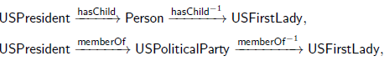
A Meta Path Generation Framework _{[Meng WWW’15]}
Meta-paths
Example
node pairs
Meta Path
Generation
(B. Obama, M. Obama)
(B. Clinton, H. Clinton)
Knowledge Base
Relevance
Function
(Yago)
(Linear Function)
Challenge: Each node and edge can have many class labels. The number of candidate meta paths grows exponentially with their path lengths.
Notes:
A user provides example pairs
Meta paths are generated through heuristics search

Slide 16
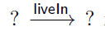

Generating Meta Paths in 2 Phases
Meta-paths
Example
node pairs
Link Type
Node Type
Knowledge Base
Relevance
Function
1. Select important meta paths based on links.
2. Fill in meta-paths with node types
Notes:
Challenge instead of idea
Why divide?

Slide 17
Phase 1: Link-Only Path Generation
Forward Stage-wise Path Generation(FSPG): iteratively generate the most related meta-paths and update the model
To train the weights on meta paths.
Updated model
Get one most related meta path m
Example Pairs
Model Training
Converge
N
Meta path m
Y
Based on the Least-Angle Regression (LARS) model
[Efron, Ann.Stat’04]
FINISH
GreedyTree
Notes:
Principle
Not detail

Slide 18
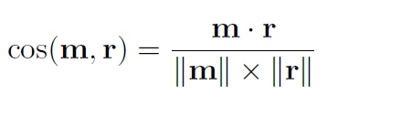
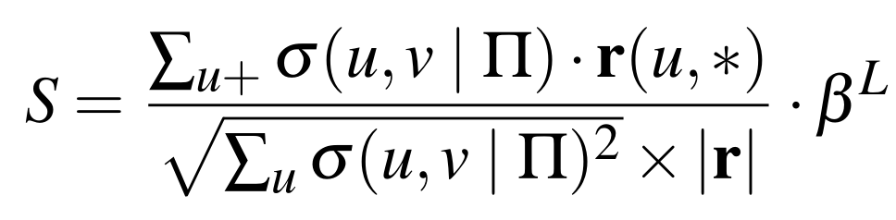
Meta path Generation
GreedyTree
A tree that greedily expands the node which has the largest priority score
Priority Score : related to the correlation between m and r
m is the vector expression of a meta path, r is the residual vector which evaluates the gap between the truth and current model
m
r
Details in WWW’05
Notes:
Introduce GreedyTree in whole structure
Explain m and r
Do not talk to much about Hide the equation. Tell them to read the paper. It is quite complex here.

Slide 19
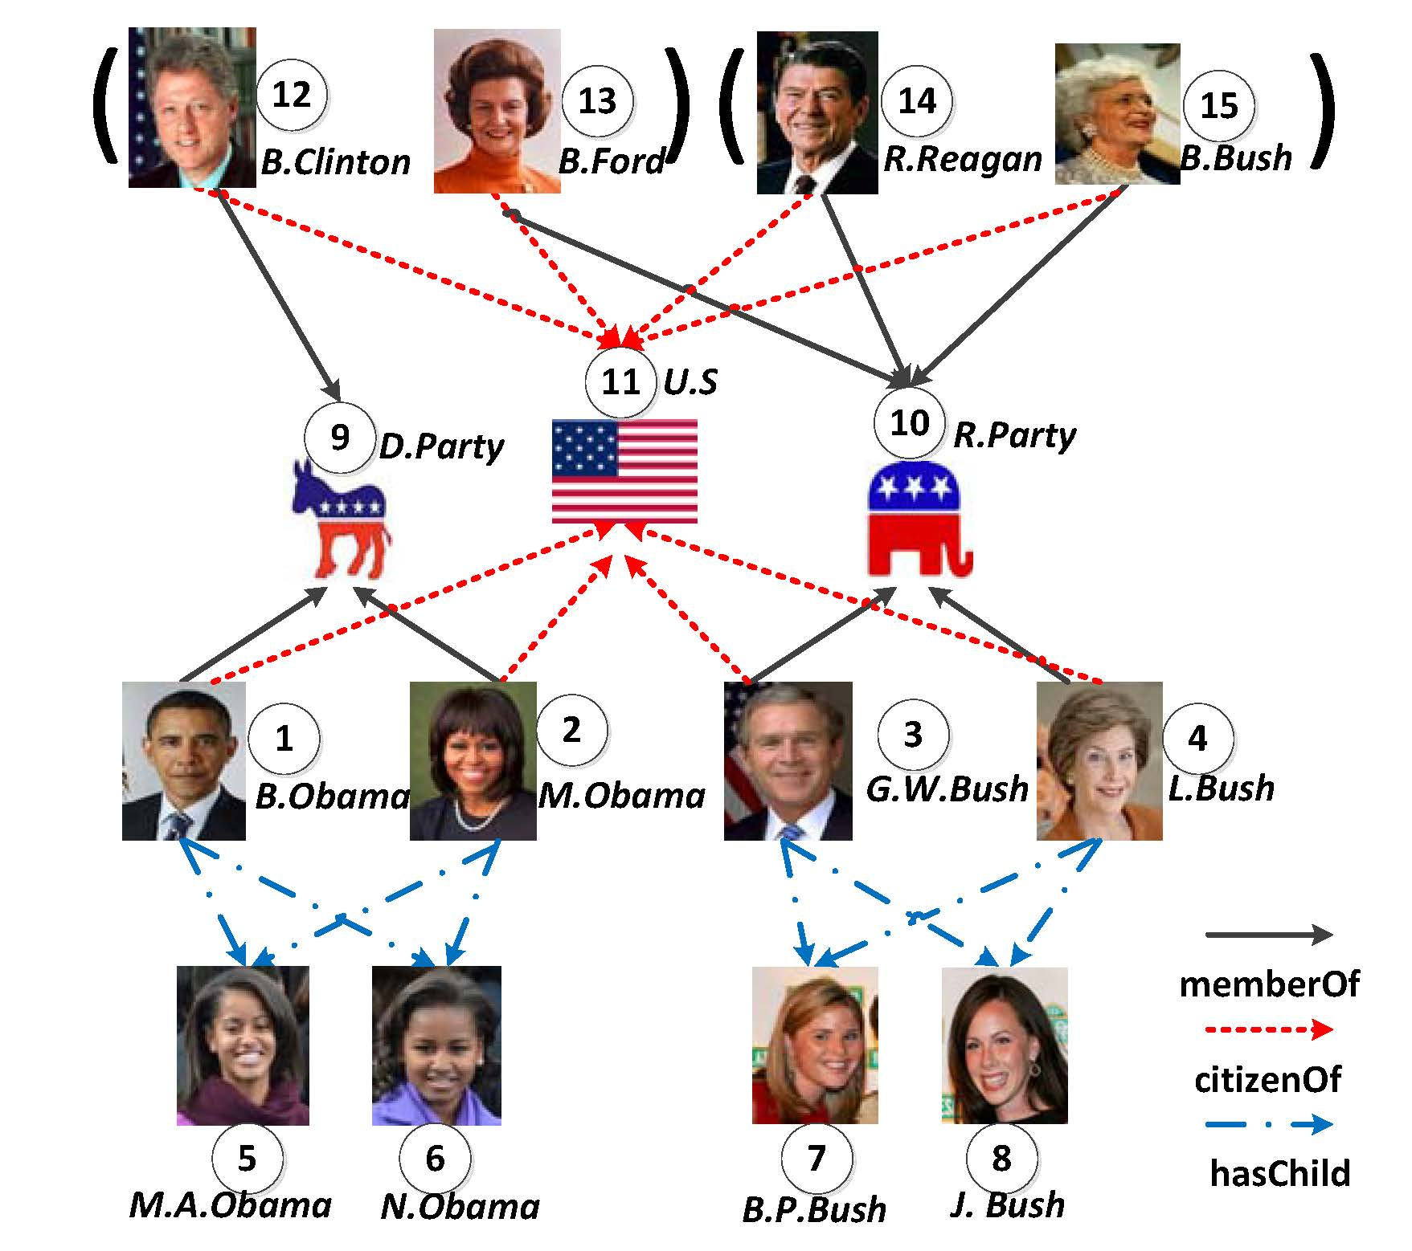
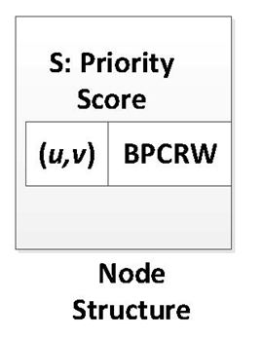
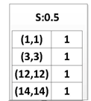
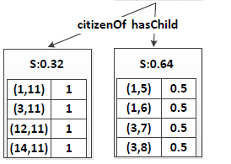
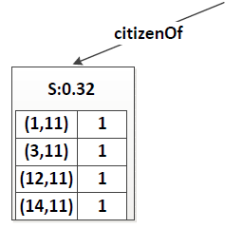
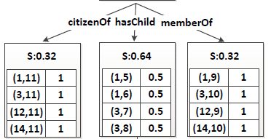
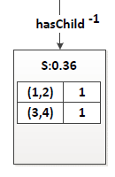
Meta path Generation
GreedyTree
Notes:
Less detail
Show paths in animation

Slide 20
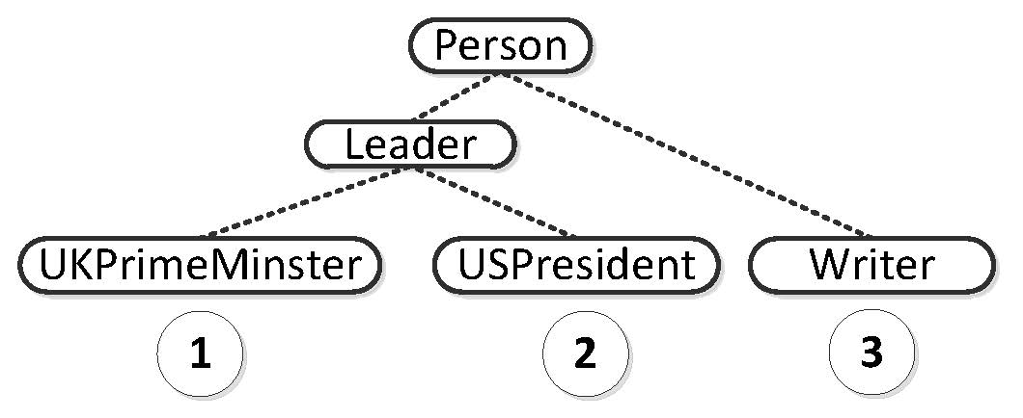
Phase 2: Node Class Generation
Why node classes?
A link only meta path may introduce some unrelated result pairs
It is less specific than
Solution : Lowest Common Ancestor(LCA)
Record the LCA in the node of GreedyTree
Notes:
Solution 1: existing one instead of solution
Pros and Cons of LCA and TFOF

Slide 21
Experiments
Datasets
DBLP (4 areas)
(Database, Data Mining, Artificial Intelligence, Information Retrieval).
14376 papers, 14475 authors, 8920 topics, 20 venues.
Yago
A Knowledge Base derived from Wikipedia, WordNet and GeoNames.
CORE Facts: 2.1 million nodes, 8 million edges, 125 edge types, 0.36 million node types
Link-prediction evaluation
Select n pairs of certain relationships as example pairs
Randomly select another m pairs to predict the links
Notes:
Not the only application—only an evaluation, objective
Can be used in others

Slide 22
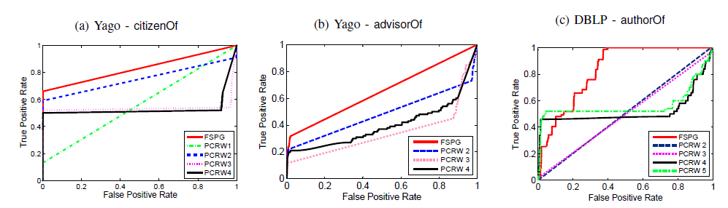
Experiment 1: Effectiveness
Baseline: enumerate all meta paths within a given max length L=1..4
L is small ➔ low recall.
L is large ➔ low precision.
ROC for link prediction
Notes:
Explain ROC- larger area is better

Slide 23
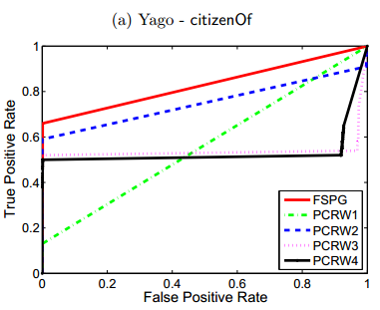
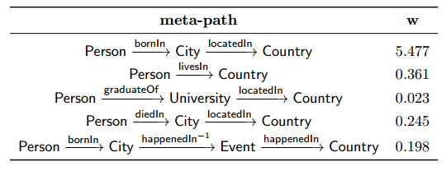
Experiment 2
Case study: Yago citizenOf
Better than direct link(PCRW 1)
Better than best PCRW 2
Better than PCRW 3,4
5 most relevant meta paths for citizenOf
Notes:
PCRW_k means the linear combination of meta paths with length no longer than k

Slide 24
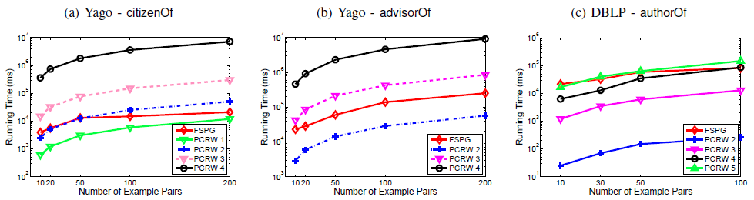
Experiment 3: Efficiency
In Yago, 2 orders of magnitude better than paths with lengths more than 2.
In DBLP, the running time is comparable to PCRW 5, but the accuracy is much better.
Running time of FSPG

Slide 25
Questions
Where do meta paths come from?
Provided by experts [Sun VLDB’11]
Not easy for a complex schema!
Enumeration within a given length of meta paths [Cohen ECML’11]
How to find this length?
Can a meta path be extended to capture non-path relationship?
Part 1
Part 2
Notes:
Limitations of Existing work

Slide 26
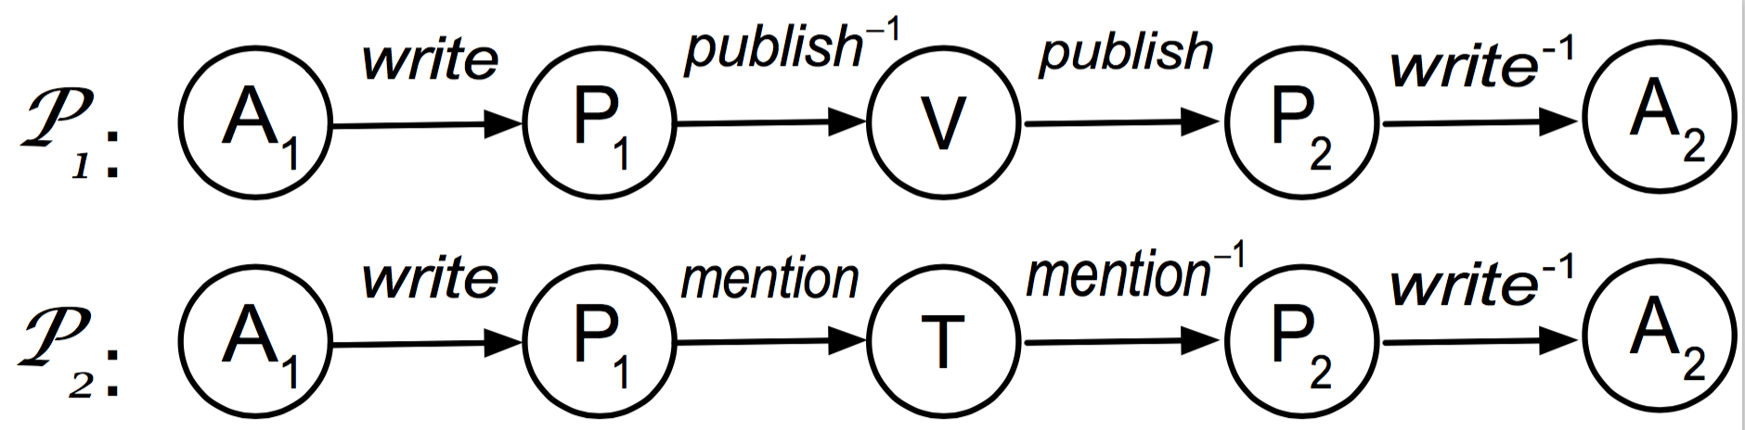
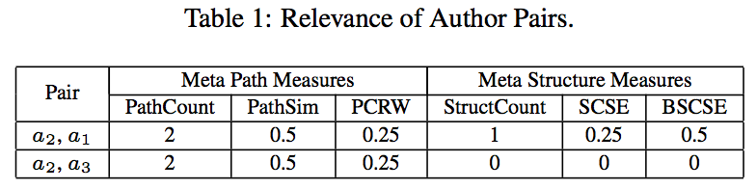
Limitations of Meta Paths
How to discover common nodes in different meta paths?
e.g., a researcher wants to search for some authors who have published papers in the same venue and in the same topic with his papers.

Slide 27
Limitations of Meta Paths
How to discover common nodes in different meta paths?
e.g., a researcher wants to search for some authors who have published papers in the same venue and in the same topic with his papers.

Slide 28
Limitations of Meta Paths
How to discover common nodes in different meta paths?
e.g., a researcher wants to search for some authors who have published papers in the same venue and in the same topic with his papers.

Slide 29

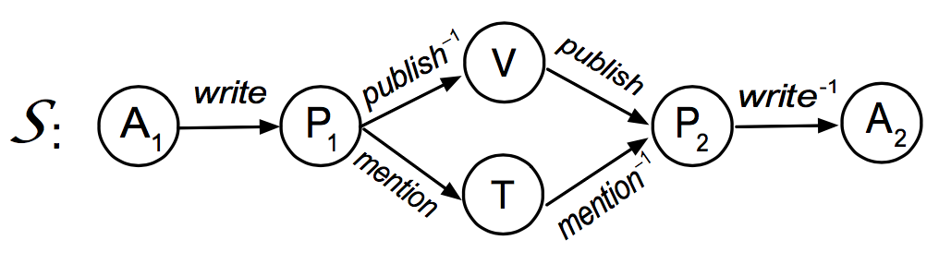
Our Contributions for Part 2: Meta Structure
A meta structure is a directed acyclic graph (DAG) with a single source and sink (target) node
More expressive than a meta path.
[Huang KDD’16] ZP. Huang “Meta Structure: Computing Relevance on Large Heterogeneous Information Networks” KDD 2016
Notes:
Can express more semantic meaning.

Slide 30
Relevance Measure 1: StructCount
StructCount: extension of PathCount
Given x and y, how many instances of meta-structure S connect x and y?
StructCount biases towards popular objects with a large number of links.
Notes:
Similar to PathCount

Slide 31
Layers of Meta Structure
The layer of meta structure is a topological ordering of a DAG
1
2
3
4
5

Slide 32

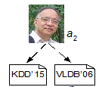

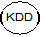


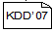
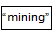
Relevance Measure 2: SCSE
Structure Constrained Random Walk (SCSE): extension of PCRW.
1.0
0.5
0.5
0.25

Slide 33
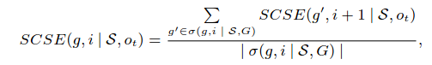
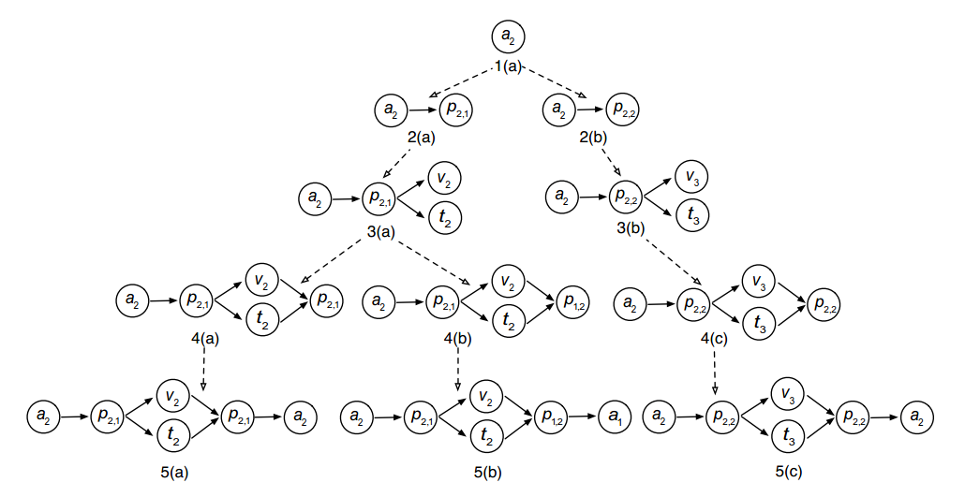
Relevance Measure 2: SCSE
Notes:
Structure Constrained Random Walk (SCSE): extension of PCRW.

Slide 34
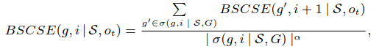
Relevance Measure 3: BSCSE
Biased Structure Constrained Random Walk (BSCSE): extension of BPCRW.
A combination of SC and SCSE
SC 0 ← α → 1 SCSE

Slide 35
Relevance Measures: Summary
Meta Path | Meta Structure [KDD’16] | Meaning
PathCount | StructCount | # of meta-path/structure instances
PCRW | SCSE | Random walk probability on meta-path/structure
BPCRW [WWW’15] | BSCSE | Combination of count and probability

Slide 36
i-LTable
Index the probability distribution starting from the i-th layer of a meta structure.
Key / layer 3 | Value
<ICDM, social> | <Pei, 1.0>
<KDD, mining> | <Pei, 0.5>
 | <Han, 0.5>
<VLDB, efficient> | <Han, 1.0>
<VLDB, privacy> | <Yang, 1.0>
<AAAI, efficient> | <Yang, 1.0>

Slide 37
Experiments (Effectiveness)
Entity Resolution
Relevance Ranking
Clustering

Slide 38
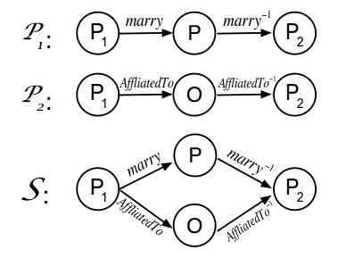
Entity Resolution
On YAGO, we have duplicated entities, e.g., Barack_Obama and Presidency_Of_Barack_Obama
We retrieve the top-k pairs; the high relevance of the node pairs indicates that the nodes are duplicated
Area under PR-Curve (AUC)
 | P₁ |  |  | P₂
Measure | PathCount | PCRW | PathSim | PathCount | PCRW | PathSim
AUC | 0.1324 | 0.0120 | 0.0097 | 0.0003 | 0.0014 | 0.0002
 | Linear Combination(optimal ) |  |  | Meta Structure S
Measure | PathCount | PCRW | PathSim | SC | SCSE | BSCSE*
AUC | 0.2898 | 0.2606 | 0.2920 | 0.5556 | 0.5640 | 0.5640

Slide 39
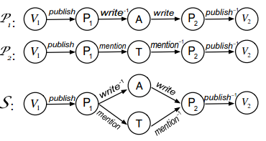
Relevance Ranking
We label the relevance of venues in DBLP_4_Area.
0 = not relevant; 1 = relevant; 2 = strongly relevant.
E.g., <SIGMOD, VLDB>: 2; <SIGMOD, CIKM>: 1
Normalized Discounted Cumulative Gain (nDCG)
 | P₁ |  |  | P₂
Measure | PathCount | PCRW | PathSim | PathCount | PCRW | PathSim
nDCG | 0.9004 | 0.9047 | 0.9083 | 0.8224 | 0.8901 | 0.8834
 | Linear Combination(optimal ) |  |  | Meta Structure S
Measure | PathCount | PCRW | PathSim | SC | SCSE | BSCSE*
nDCG | 0.9004 | 0.9100 | 0.9083 | 0.9056 | 0.9104 | 0.9130

Slide 40
Clustering
Clustering on venues in YAGO
Normalized Mutual Information (NMI) and Purity
 | P₁ |  |  | P₂
Measure | PathCount | PCRW | PathSim | PathCount | PCRW | PathSim
NMI | 0.4932 | 0.6866 | 0.6780 | 0.3595 | 0.6866 | 0.5157
 | Linear Combination(optimal ) |  |  | Meta Structure S
Measure | PathCount | PCRW | PathSim | SC | SCSE | BSCSE*
NMI | 0.4932 | 0.6866 | 0.6780 | 0.3202 | 0.8065 | 0.8065
 | P₁ |  |  | P₂
Measure | PathCount | PCRW | PathSim | PathCount | PCRW | PathSim
Purity | 2.75 | 3.50 | 3.00 | 2.50 | 3.50 | 2.75
 | Linear Combination(optimal ) |  |  | Meta Structure S
Measure | PathCount | PCRW | PathSim | SC | SCSE | BSCSE*
Purity | 2.75 | 3.50 | 3.50 | 2.25 | 3.50 | 3.50

Slide 41
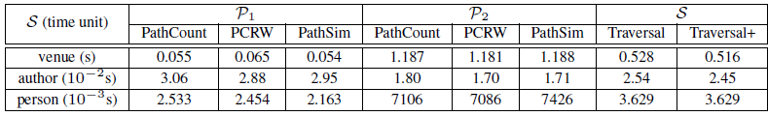
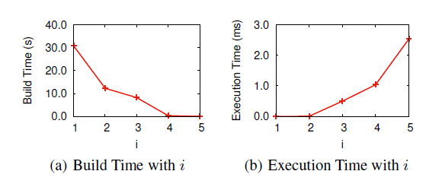
Experiment (Efficiency)
Comparable efficiency as meta path-based methods (No index)
i-LTable:
Notes:
Don’t have to explain the number in details.
Just say that we have comparable running time to the meta path measures.
In case some one asks us,
Traversal is the basic recursive algorithm
Traversal+ is the basic one + compressed E-Tree

Slide 42
Conclusions
We examine relevance measures for HINs.
We study how to learn meta paths based on example pairs.
The meta structure effectively evaluates the relevance between HIN nodes connected with complex relationships.
Notes:
Currently we are studying the learning of meta structures.

Slide 43
References
[Meng WWW’15] CP. Meng “Discovering Meta-Paths in Large Heterogeneous Information Networks” WWW 2015
[Huang KDD’16] ZP. Huang “Meta Structure: Computing Relevance on Large Heterogeneous Information Networks” KDD 2016
[Yu EDBT’13]: ] C. Shi , P. Yu“Relevance Search in Heterogeneous Network” EDBT’13
[Han VLDB’11] Y. Sun, J. Han, X. Yan, P. S. Yu, and T. Wu, “PathSim: Meta Path-Based Top-K Similarity Search in Heterogeneous Information Networks”, VLDB'11
[Han ASONAM’11] Y. Sun, R. Barber, M. Gupta, C. Aggarwal and J. Han, "Co-Author Relationship Prediction in Heterogeneous Bibliographic Networks", ASONAM'11
[Han CIMK’12]Y. Sun, R. Barber, M. Gupta, C. Aggarwal and J. Han, "Meta-Path Selection with User Guided Object Clustering in Heterogeneous Information Networks ", CIKM'12
[Sun VLDB’11]L. Sun, R. Cheng and etc On Link-based Similarity join, VLDB 2011
[Han KDD’12]J. Han, Y. Sun, X. Yan, and P. S. Yu, “Mining Heterogeneous Information Networks“
[Cohen ECML’11]W. Cohen, N. Lao “Relational Retrieval Using a Combination of Path-Constrained Random Walks” ECML 2011
[Weinberger JMLR’09] Weinberger “Distance Metric Learning for Large Margin
Nearest Neighbor Classiﬁcation” Journal of Machine Learning Research 10 (2009) 207-244
[Chopra CVPR’05]S.Chopra “Learning a similarity metric discriminatively, with application of face verification” CVPR 2005
[Efron Ann.Stat’04] Efron, Bradley, et al. "Least angle regression." The Annals of statistics 32.2 (2004): 407-499.

Slide 44



Thank you!
Dr. Reynold Cheng:
URL: http://www.cs.hku.hk/~ckcheng/
email: ckcheng@cs.hku.hk
Mr. Zhipeng Huang (PhD student):
URL: http://www.cs.hku.hk/~zphuang/
email: zphuang@cs.hku.hk
Mr. Jason Meng (Former MPhil, now Purdue PhD)
Jason.mengcp@gmail.com

Slide 45


Relevance based on Multiple Meta Paths
Use a linear function F to combine the relevance scores of multiple meta paths
S:
t:
Notes:
Highlight our propose
Use a same example

